Slide 1
Project 4: Flow Control
Daniel Krizak and Alex Sweet
12/06/17

Slide 2
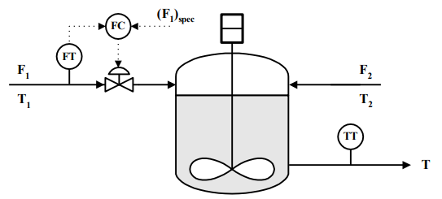
Reactor Scheme

Slide 3
Variable Declarations
F1- mass flowrate of stream 1 (kg/s)
t- time- (s)
Fout – outlet flow rate (kg/s)

Slide 4
Constants/ Parameters
T1: 25°C ; T2:75 °C ; Tt(0): 50
F2: 5kg/s
Mt(0): 100kg
F1(0)= 5kg/s
F1(10)= 4 kg/s
dF1/dt: -.1 kg/s

Slide 5
Mass Balance
In - out + generation + CV = CV + accumulation
F1 + F2 - Fout + rV = dM/dt
Accumulation and generation are 0, so
Fout = (F1 + F2)
The control volume has constant mass such that the sum of inlet flow and the outlet flow are equal

Slide 6
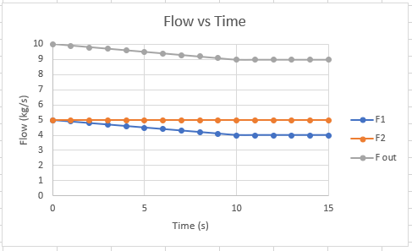
Mass Flows

Slide 7
Energy Balance
In - out + generation = accumulation
There is no generation or accumulation therefore the outlet is equal to the inlet flows
F1*T1+F2*T2 = (F1+F2)*Tout

Slide 8
Energy Balance
F1*T1 + F2*T2 = (F1+F2)*Tout
F1 is the only non constant in the energy balance
F1 = F1in - (dF1/dt) from 1 to 10 seconds.

Slide 9
Adding the Control Volume
While the Control volume has no impact on the mass flow amounts of input or output, the thermal balance is impacted because it creates a non-instantaneous response in the outlet temperature.

Slide 10
New outlet (accounting for CV)
F1*T1 + F2*T2 + 100*T(0) = (F1+F2+100)*Tout
Where F1= 5 -0.1t for 0<t<10
and F1= 4 at 10<t
Flow energy balance
New terms to account for CV

Slide 11
Steady State Approach
No accumulation or generation:
In = out at t -> Ꝏ
25 ° *4+75 ° *5= 9*Tout
Tout = 52.77777777777°F
We should find this Tout value if we allow the program running for a sufficient number of runs

Slide 12
Integral Solution
The integral method breaks the time down into equal segments of step size which are summed over the integral of each area to converge on the final solution.

Slide 13
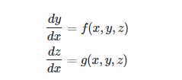
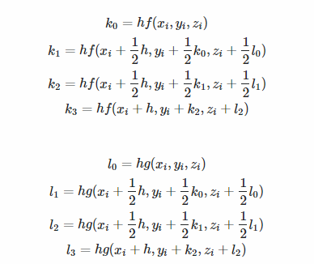
4th Order (Runge) Method

Slide 14
Program Variables and Parameters
M= initial mass (CV)
T1= temp in stream 1
T2= temp in stream 2
F1= flow of stream 1
t= time; t0= initial; tf= final

Slide 15
More Program Variables
IntX: array for x values solved by integration
IntY: array for y values solved by integration
RkX: array for x values solved by range
RkY: array for y values solved by range
Steps= numstep= (50) number of times the interval has been divided equally (used in sizing arrays)

Slide 16
More Program Variables
Time interval given by t(0) and tf values
Step size gives the step length value

Slide 17
Coded Energy Balance
Solved for temperature of the tank which for a cstr is modeled as equal to the temperature at the outlet

Slide 18
Bonus Section
The bonus section requires the addition of another time lag variable which will further delay the approach to steady state
How long to approach to 2 decimal places?
P1: 72 sec
τ1(2): 73.5 sec
τ2(4): 77 sec
τ(6): 80 sec

Slide 19
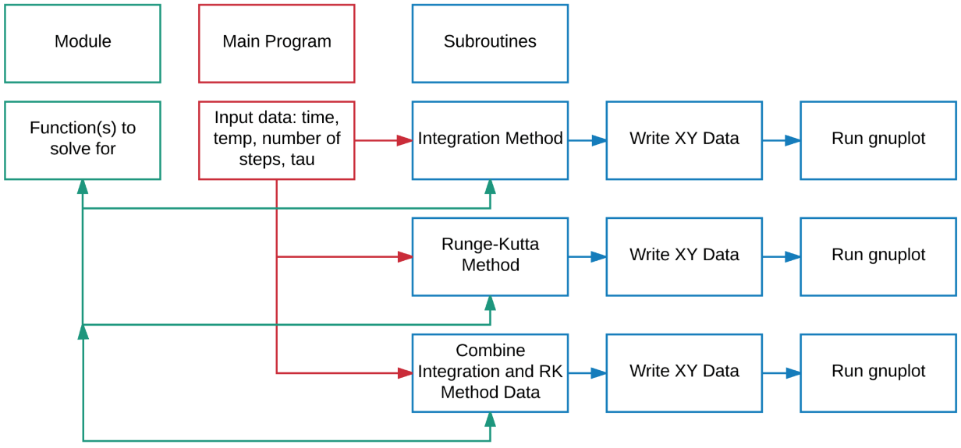
Notes:
All required modification to handle the additional equation in part 2

Slide 20
Notes:
Added additional Function

Slide 21
Function
Function func(t, Temp)
Double Precision, intent (in):: t, Temp
Double Precision:: func, M, F1, F2, T1, T2
M = 100.00
T1 = 25.00
T2 = 75.00
F2 = 5.00
!F1 is a function of time F1(t=0) = 5kg/s
If (t>=10.0) then
F1 = 4.00
else
F1 = 5.00 - 0.10*t
End if
!Sets the value of the function
func = 1/M*(F1*T1 + F2*T2 - (F1+F2)*Temp)
End Function

Slide 22
Notes:
Added additional Function

Slide 23
Integration Method
!Calculates the steps size and sets the initial values based on the input data
stepSize = (finalX - startX)/numSteps
xint(0) = startX
yint(0) = startY
!Do loop runs the interative calculation of the Integration Method
Do i = 0, numSteps - 1
yint(i+1) = yint(i) + stepSize*func(xint(i), yint(i))
xint(i+1) = xint(i) + stepSize
End Do
!The write_xy_data subroutine writes the data in the arrays to the specified data file
Call write_xy_data('/Users/DanielK/Desktop/Fortran/IntMethod.dat', numSteps, xint, yint, err)
!The run_gnuplot subroutine uses the given script to create a graph of the data
Call run_gnuplot('/Users/DanielK/Desktop/Fortran/IntMethod.txt')

Slide 24
Notes:
Only had to troubleshoot the RK Method for part 2 as the coefficients k1, k2, k3, k4 were not correct for when there are two variables to solve for

Slide 25
Runge-Kutta Method
!Do loop runs the interative calculation of the RK Method
Do i = 0, numSteps - 1
k1 = stepSize*func(xrk(i), yrk(i))
k2 = stepSize*func((xrk(i)+stepSize/2), (yrk(i)+k1/2))
k3 = stepSize*func((xrk(i)+stepSize/2), (yrk(i)+k2/2))
k4 = stepSize*func((xrk(i)+stepSize), (yrk(i)+k3))
yrk(i+1) = yrk(i) + (k1 + 2.00*k2 + 2.00*k3 + k4)/6.00
xrk(i+1) = xrk(i) + stepSize
End Do
!The write_xy_data subroutine writes the data in the arrays to the specified data file
Call write_xy_data('/Users/DanielK/Desktop/Fortran/RKMethod.dat', numSteps, xrk, yrk, err)
!The run_gnuplot subroutine uses the given script to create a graph of the data
Call run_gnuplot('/Users/DanielK/Desktop/Fortran/RKMethod.txt')

Slide 26
Notes:
Adapted to handle additional variables to write into specific datafiles for different values of tau

Slide 27
Combine Data
!Do loops inputs all the data from both solutions into a single array
Do i = 0, numSteps
allpts(i,0) = xint(i)
allpts(i,1) = yint(i)
allpts(i,2) = yrk(i)
End Do
!The run_gnuplot subroutine uses the given script to create a graph of the data
Call run_gnuplot('/Users/DanielK/Desktop/Fortran/IntRKMethod.txt')

Slide 28
Notes:
Adapted to handle additional variables to write into specific datafiles for different values of tau

Slide 29
Write XY Data
open ( unit = file_unit, file = data_filename, status = 'replace', &
iostat = ios )
!Edited to start at i=0
do i = 0, n
write ( file_unit, * ) x(i), y(i)
end do
close ( unit = file_unit )
write ( *, '(a)' ) ' Wrote the GNUPLOT XY data file "' // &
trim ( data_filename ) // '"'

Slide 30
Notes:
Adapted to handle additional variables to write into specific datafiles for different values of tau

Slide 31
Run GNUPlot
write ( command, * ) 'gnuplot ' // command_filename
write ( *, '(a)' ) ' '
write ( *, '(a)' ) 'GNUFOR:'
write ( *, '(a)' ) ' Issuing the command:"' // trim ( command ) // '".'

Slide 32
Program Troubleshooting
This section outlines the procedure by which the program was tested to find the source of the error originally experienced.

Slide 33
Error: T -> -Infinity
as t -> infinity
Notes:
Error: T-> -Infinity as t-> infinity
Changed the way F1 was calculated, required if statement to determine if it was past t=10s

Slide 34
Change
F1 = 5.00 - 0.10*t
!F1 is a function of time F1(t=0) = 5kg/s
If (t>=10.0) then
F1 = 4.00
else
F1 = 5.00 - 0.10*t
End if

Slide 35
Error: T(t=0) = 0 on graph
Notes:
Error: Starting value = 0 on graph
This subroutine came from: http://people.sc.fsu.edu/~jburkardt/f_src/gnufor/gnufor.html and required modifying the input array such that the index started form 0

Slide 36
Change
real ( kind = 8 ) x(n)
real ( kind = 8 ) y(n)
real ( kind = 8 ) x(0:n)
real ( kind = 8 ) y(0:n)

Slide 37
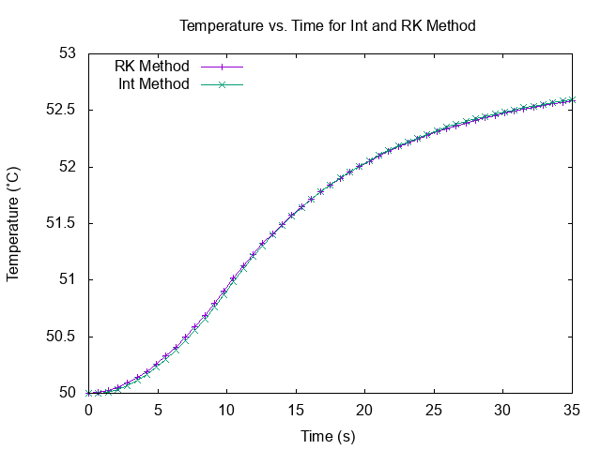
Part 1 Graph

Slide 38
Program Modification for Part 2
This section outlines the procedure by which the program was adapted to solve part 2 of the problem.

Slide 39
Notes:
Added additional Function

Slide 40
Additional Function
Function func(t, F1, tau)
Double Precision, intent (in):: t, F1
Double Precision:: func, F1spec, tau
!tau = 2.00
!F1spec is a function of time F1(t=0) = 5kg/s
F1spec = 5.00 - 0.10*t
!Sets the value of the function
func = 1/tau*(F1spec - F1)
End Function

Slide 41
Notes:
Added additional Function

Slide 42
Integration Method Modification
!Do loop runs the interative calculation of the Integration Method
Do i = 0, numSteps - 1
xint(i+1) = xint(i) + stepSize
yint(i+1) = yint(i) + stepSize*func(xint(i), yint(i), tauin)
zint(i+1) = zint(i) + stepSize*func2(xint(i), yint(i), zint(i))
End Do

Slide 43
Notes:
Only had to troubleshoot the RK Method for part 2 as the coefficients k1, k2, k3, k4 were not correct for when there are two variables to solve for

Slide 44
Runge-Kutta Modification
!Do loop runs the interative calculation of the RK Method
Do i = 0, numSteps - 1
xrk(i+1) = xrk(i) + stepSize
k1 = stepSize*func(xrk(i), yrk(i), tauin)
k2 = stepSize*func((xrk(i)+stepSize/2), (yrk(i)+k1/2), tauin)
k3 = stepSize*func((xrk(i)+stepSize/2), (yrk(i)+k2/2), tauin)
k4 = stepSize*func((xrk(i)+stepSize), (yrk(i)+k3), tauin)
yrk(i+1) = yrk(i) + (k1 + 2.00*k2 + 2.00*k3 + k4)/6.00
k1z = stepSize*func2(xrk(i), yrk(i), zrk(i))
k2z = stepSize*func2((xrk(i)+stepSize/2), (yrk(i)+k1/2), (zrk(i)+k1z/2))
k3z = stepSize*func2((xrk(i)+stepSize/2), (yrk(i)+k2/2), (zrk(i)+k2z/2))
k4z = stepSize*func2((xrk(i)+stepSize), (yrk(i)+k3), (zrk(i)+k3z))
zrk(i+1) = zrk(i) + (k1z + 2.00*k2z + 2.00*k3z + k4z)/6.00
End Do

Slide 45
Notes:
Adapted to handle additional variables to write into specific datafiles for different values of tau

Slide 46
Combined Data Modification
!The run_gnuplot subroutine uses the given script to create a graph of the data
Call run_gnuplot('/Users/DanielK/Desktop/Fortran/IntRKMethod_'//namein//'.txt')

Slide 47
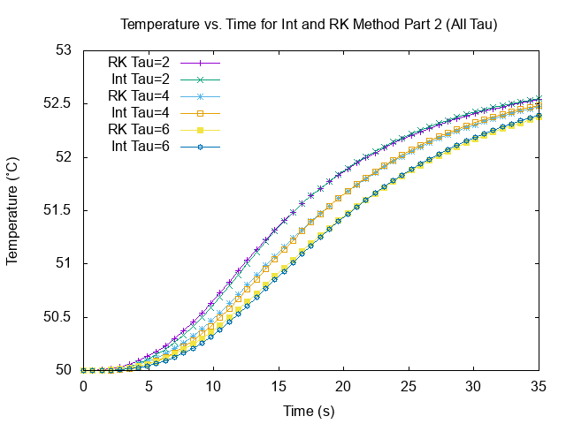
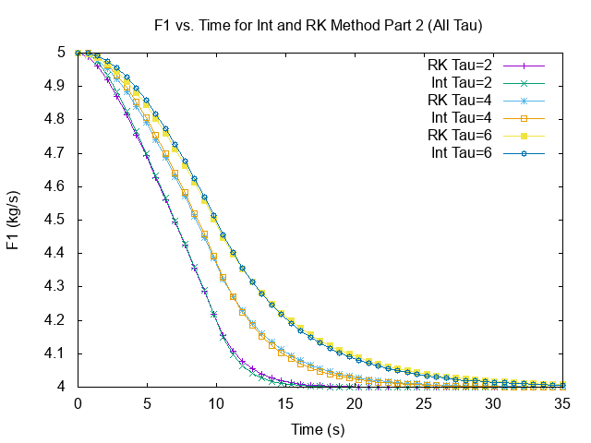
Part 2 Graphs

